Slide 1
Time scaling and pitch shifting
Analysis identical to any standard phase vocoder
Synthesis hop size varied for time compression/expansion
Changes time scale without changing pitch
If pitch shifting, interpolate back to original time scale
Now pitch changed, but time scale is unchanged

Slide 2
Pitch shifting
When playing audio samples, playback speed and pitch are usually coupled
How can we change pitch of sound without changing its speed?
This cannot be done through filtering because effect is nonlinear
For pitch shifter, output signal has energy at different frequencies than input
Linear systems cannot create energy at frequencies that were not present in input
phase vocoder can help...
read pointer
(play head)

Slide 3
Pitch shifting
Any signal can be represented as sum of sinusoids
DFT gives snapshot of magnitudes and phases
From phase, we calculated precise frequencies for each bin
Pitch shifting in frequency domain involves scaling each frequency
Multiply each frequency by constant ratio: >1 raises pitch, <1 lowers pitch
Convert frequencies back to magnitudes and phases of each bin
for each hop:
input block
Apply
window
Phase to
frequency
FFT
frequency
ratio
output block
Apply
window
Frequency to phase
IFFT

Slide 4
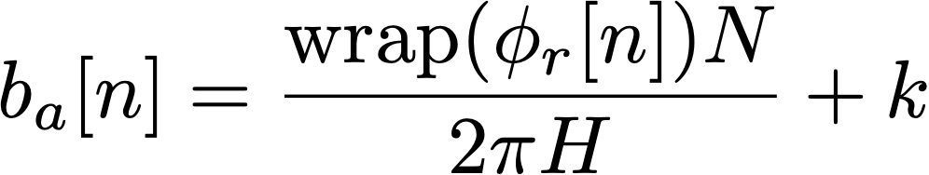
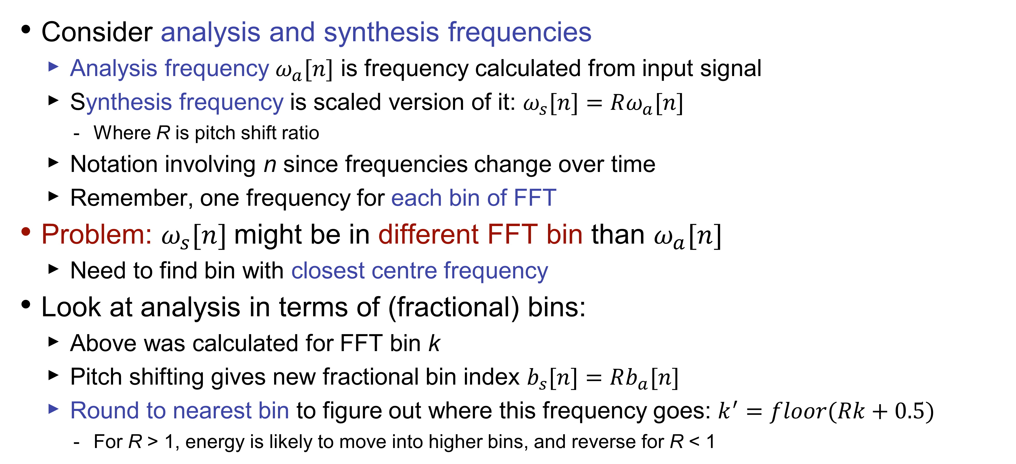
Frequency scaling
Consider analysis and synthesis frequencies
Analysis frequency $ω_{a}[n]$ is frequency calculated from input signal
Synthesis frequency is scaled version of it: $ω_{s}[n]=Rω_{a}[n]$
Where R is pitch shift ratio
Notation involving n since frequencies change over time
Remember, one frequency for each bin of FFT
Problem: $ω_{s}[n]$might be in different FFT bin than $ω_{a}[n]$
Need to find bin with closest centre frequency
Look at analysis in terms of (fractional) bins:
Above was calculated for FFT bin k
Pitch shifting gives new fractional bin index $b_{s}[n]=Rb_{a}[n]$
Round to nearest bin to figure out where this frequency goes: $k^{′}=floor(Rk+0.5)$
For R > 1, energy is likely to move into higher bins, and reverse for R < 1

Slide 5

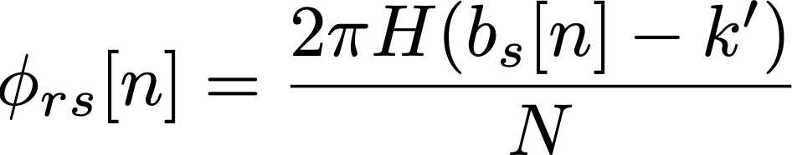
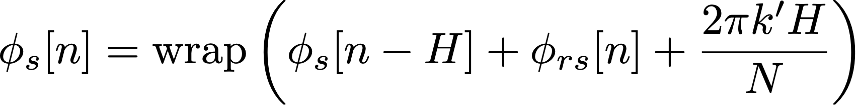
Frequency to phase
Based on bin frequency, calculate phase difference since last hop
Not an absolute phase; we need to remember each bin’s phase from last hop
The process of calculating the bin phase is the reverse of the analysis
Frequency shift gave us a bin k’ and a fractional bin number
Use it to calculate the phase remainder:
How much more or less will the phase advance at the synthesis frequency vs. the bin centre frequency
Then consider the expected phase shift based on the bin centre frequency, and add these to the phase of bin k’ at the last hop
Wrap the phase to be in the ±π range
Meanwhile, the magnitude of the bin doesn’t change in the pitch shift process

Slide 6


Frequency to phase: code
We are calculating the phase difference from one hop to the next
Therefore, we need a global variable to hold the synthesis phases from the last hop
Since we need to hold a value for each FFT bin, this variable should be an array
Each hop, we add the calculated phase difference to the output phase
Magnitude stays the same
Then we convert back to real and imaginary values, as before:
Real component: Imaginary component:
The functions cosf_neon() and sinf_neon() from the Ne10 library are faster than sin() and cos()
Another efficiency trick: exploit the symmetry of the FFT
We only need to calculate up to (and including) bin N/2
Above this, the bins are conjugate symmetric:
Same real component; negative imaginary component

Slide 7


Implement pitch shifter
Overlap-add process is implemented for you
Analysis step (phase to frequency) done previously
Implement synthesis step:
Multiply each frequency component by the pitch shift value:
Check which bin component belongs in:
Calculate phase of new bins:
Convert magnitude and phase to real and imaginary components
To test:
Change pitch shift value in GUI
Test with real-time audio input

Slide 8
Pitch shifting VST I
int outwritepos; // Temporary write pointer
float *inputBufferData; // Buffered input samples awaiting FFT
int inputBufferLength; // Length of the input buffer (in samples)
float *outputBufferData; // Buffered output samples for overlap-add
int outputBufferLength; // Length of the output buffer (in samples)
int sampsincefft; // Counter of how many samples have elapsed since last FFT
float *windowBuffer; // Buffer that holds the analysis window function
int windowBufferLength; // Length of the analysis window function
float *synthWindowBuffer; // Buffer that holds the synthesis window function
int synthesisWindowLength;// Length of the synthesis window
float *fftTimeDomain; // Buffer that holds time-domain samples for the FFT calculation
float *fftFrequencyDomain; // Buffer that holds frequency-domain samples from FFT
float fftScaleFactor; // Scaling factor to normalize output level; depends on window/hop sizes
float *resampledOutput; // Buffer holding resampled (interpolated) output from FFT
float **lastPhase; // Previous phase values for each bin and channel
float **psi; // Adjusted phase values for each bin and channel
int fftTransformSize_; // Size of the FFT calculation (in samples); normally equals
// window size but could be longer
double pitchRatio_; // Ratio of output to input frequency
int analysisHopSize_; // Hop size parameter for input (in samples)
int synthesisHopSize_; // Hop size parameter for output (in samples)
// synthesis / analysis size should match pitchRatio_

Slide 9
Pitch shifting VST II
executes the pitch shift for one (overlapped) FFT window
fftw_execute(fftForwardPlan_);
for (int i = 0; i < fftTransformSize_; i++) {
// Convert bin into magnitude-phase representation
double magnitude = sqrt(fftFrequencyDomain[i][0] * fftFrequencyDomain[i][0] +fftFrequencyDomain[i][1] * fftFrequencyDomain[i][1]);
double phase = atan2(fftFrequencyDomain[i][1], fftFrequencyDomain[i][0]);
// Calculate frequency for this bin
double frequency = 2.0 * M_PI * (double)i / fftTransformSize_;
// Increment the phase based on frequency and hop sizes
double deltaPhi = (frequency * analysisHopSize_) +
princArg(phase - lastPhase[i][channel] - (frequency * analysisHopSize_));
lastPhase[i][channel] = phase;
psi[i][channel] = princArg(psi[i][channel] + deltaPhi * synthesisHopSize_);
// Convert back to real-imaginary form
fftFrequencyDomain[i][0] = magnitude * cos(psi[i][channel]);
fftFrequencyDomain[i][1] = magnitude * sin(psi[i][channel]);
}
fftw_execute(fftBackwardPlan_); // Perform inverse FFT

Slide 10
Pitch Shifting VST III
// Resample output using linear interpolation to stretch it
double outputLength = floor(fftTransformSize_ / pitchRatio_);
for(int i = 0; i < outputLength; i++) {
x = i * fftTransformSize_ / outputLength;
ix = floor(x);
dx = x - (double)ix;
resampleOutput[i] = fftTimeDomain[ix]*(1.0 - dx) + fftTimeDomain[(ix+1)%fftTransformSize_]*dx;
}
// Add the result to the output buffer, starting at the current write position
int outputBufferIndex = outwritepos;
for(int fftBufferIndex = 0; fftBufferIndex < outputLength; fftBufferIndex++) {
if (fftBufferIndex > synthesisWindowLength) outputBufferData[outputBufferIndex] += 0;
else outputBufferData[outputBufferIndex] += resampleOutput[fftBufferIndex] * fftScaleFactor * synthesisWindowBuffer[fftBufferIndex];
if(++outputBufferIndex >= outputBufferLength) outputBufferIndex = 0;
}
// Advance the write position within the buffer by the hop size
// (Use original hop size since we have resampled output back to expected length)
outwritepos = (outwritepos + analysisHopSize_) % outputBufferLength_;

Slide 11
Pitch shift limitations
Limitations of pitch shift algorithm
When shifting pitch downward, components which started out in different bins might end up in same bin (since frequencies get closer together when R < 1)
Artefacts from windowing (e.g. main lobe and side lobes) will also be shifted
If original signal has frequency components spaced more closely than FFT bins, they may not get resolved and shifted correctly
No global preservation of phase which distorts transient events
“Phasiness” is a classic problem with phase vocoder effects
Latency: longer FFT → better pitch resolution but longer latency
Big market for high-quality pitch shifting effects
Antares Auto-Tune, introduced in 1997, has become ubiquitous in pop music
Many different pitch shifting guitar pedals on the market
These effects often involve many careful optimisations for sound quality and efficiency

